Slide 1
Transforming Patient Care Paramount Issues and Opportunities in Pharmacy Practice
RHODE ISALND SOCIETY OF HEALTH SYSTEM PHARMACITS
2013 RISHP 9th Annual Future of Pharmacy Showcase
Saturday, November 2, 2013
Paul W. Abramowitz, Pharm.D., Sc.D. (Hon), FASHP
Chief Executive Officer

Slide 2
Disclosure Information
SPEAKER: Paul W. Abramowitz, Pharm.D., FASHP, Chief Executive Officer
American Society of Health-System Pharmacists
TITLE: “Transforming Patient Care: Paramount Issues and Opportunities In Pharmacy Practice”
MEETING: Rhode Island Society of Health System Pharmacists
2013 RISHP 9th Annual Future of Pharmacy Showcase
Saturday, November 2, 2013
I have no relevant financial relationships to disclose.

Slide 3
Objectives
Practice Model Change
New Methods of Care
Discuss future pharmacy practice models and new methods of care delivery to improve outcomes of care
Describe a focus on the full continuum of medication therapy to eliminate silos of care
The Accountable Care Organization
Connecting All Aspects of the Medication-Use Continuum
Discuss the ACO Model and ways in which pharmacists should participate

Slide 4
Objectives
Enhancing the Public’s Understanding of the Vital Role of the Pharmacist in their Care
Describe the importance and process for pharmacists to obtain provider status at the Federal, State and Local levels
Identify opportunities and ways pharmacists should educate the public, patients, and payors to enlist their support for availability of pharmacy care
Obtaining Provider Status for Pharmacists
Yes, It is Important!
Pharmacist Interdependent Prescribing
Optimizing Patient Outcomes
Explain how the evolution of CDTM to broaden pharmacist prescribing privileges will improve the delivery of health care

Slide 5
Practice Model Change
New Methods of Care

Slide 6
Practice Model Change - New Methods of Care
What is a Practice Model?
Defines important types and levels of patient care services
Allows for:
Application of best practices
Standardization of care
Judgment of pharmacist and individual patient needs
Notes:
6

Slide 7
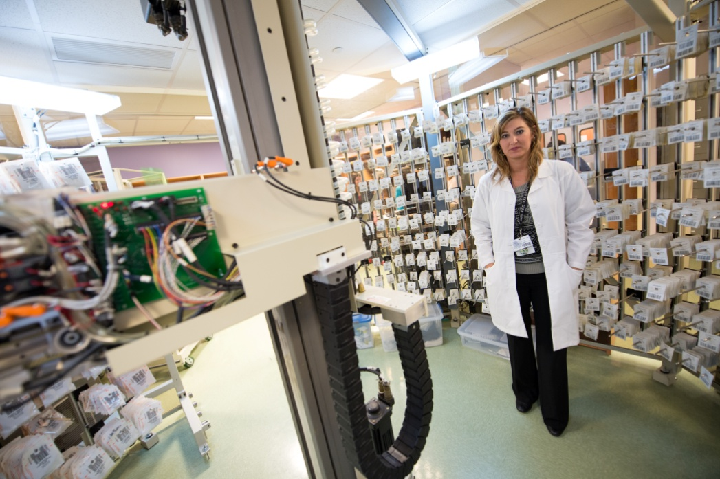
Practice Model Change - New Methods of Care
What is an Optimal Practice Model?
Incorporates roles of pharmacists, technicians, and other support personnel into the provision of interprofessional care
Encompasses patient care activities that span across all sites of care
Optimizes technology and information systems to enhance care
Notes:
7

Slide 8
Practice Model Change - New Methods of Care
Imperatives for Practice Model Change
Our Patients
Medication use and its outcomes are far from optimal in the U.S.
Admissions and readmissions to hospitals due to medication therapy are too high
Provision of primary care and management of chronic disease is inadequate to meet global needs
Wellness and prevention do not receive adequate attention
Notes:
8

Slide 9
Practice Model Change - New Methods of Care
Imperatives for Practice Model Change
Health System Spending
National Health Expenditure,$2.8 trillion in 2012, $8,952 per person, and 17.9% of GDP - projected to be 19.6% by 2021¹
Estimated waste in the healthcare system = $765 BILLION annually²
The Affordable Care Act (ACA) attempts to address these problems
ACOs are designed to reward appropriate care utilization and ultimately capitate payment but need the full participation of pharmacists
Notes:
9

Slide 10
Practice Model Change - New Methods of Care
Imperatives for Practice Model Change, “The Elevator Speech”
Pharmacists are the:
Most accessible healthcare professionals
Specifically and intensively educated and trained in drug therapy
Maximizing pharmacists integration into health care teams will improve:
Quality
Safety
Patient Satisfaction
Financial Performance
Notes:
10

Slide 11
Practice Model Change - New Methods of Care
The
Patient
Hospitals & Health Systems
Clinics
Home Care
Long-Term Care
Specialty Pharmacy
Community Pharmacies
Urgent Care
Insurers
Current Silos that Exist in the Pharmacy Practice Continuum
Lack of effective transition of care mechanisms
Less than optimal division of responsibilities
Notes:
11

Slide 12
Practice Model Change - New Methods of Care
Principles for Practice Model Redesign³
Health care will become increasingly inter-professional, team-based
Medication preparation, distribution, & dispensing should be more centralized & automated
Vast majority of pharmacists’ time must be spent providing direct patient care in all settings
We need a well-trained technician workforce to provide more complex medication-use roles
Increased definition & standard-ization of pharmacy direct care services offered for all patients is necessary

Slide 13
Practice Model Change - New Methods of Care
Principles for Practice Model Redesign³
More and more pharmacists will be practicing in clinics
Collaborative practice will evolve to include greater pharmacist responsibility for prescribing as part of coordinated health care teams in all settings
Primary care and adherence must receive a much greater emphasis by pharmacists
Every patient should receive a comprehen-sive pharmaco-therapy plan
Expect the public to insist on additional requirements for credentialing & privileging of pharmacists in general & specialty practices

Slide 14
Practice Model Change - New Methods of Care
Change How We Think about Providing Care as Pharmacists
Not Just Acute Care (Hospitals) or Ambulatory Care (Community and Clinics), But PATIENT CARE!
Accessibility of Care and Remote Care
ASHP’s vision is that medication use will be optimal, safe, and effective for all people all of the time.

Slide 15
Practice Model Change - New Methods of Care
Change How We Think about Providing Care as Pharmacists
Inter and Intraprofessional Care
Interprofessional Care⁴ - the provision of comprehensive health services to patients by multiple caregivers working collaboratively to deliver quality care within and across settings
Intraprofessional Care – team of providers from the same profession working together to deliver care in and across different settings
We have focused on INTERprofessional but INTRAprofessional also requires attention!

Slide 16
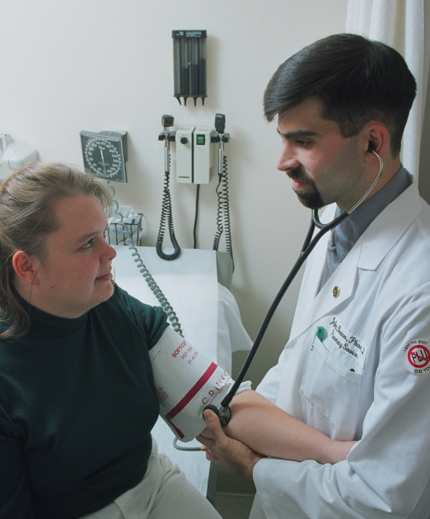
Practice Model Change - New Methods of Care
Pharmacy Care – Every Patient in Every Site of Care
Medication therapy services should include³:
Complete medication history & reconciliation
Development of comprehensive, multidisciplinary, accessible and transferable pharmacotherapy plan
Ongoing medication assessment for appropriateness
Application of best practices
Adherence assessment and improvement
Target patients that require enhanced or specialty pharmacy care
Primary and preventative care
Chronic disease management
Manage transitions of care

Slide 17
Practice Model Change - New Methods of Care
IMPROVING HEALTH – OPTIMIZING OUTCOMES
“Expanded pharmacy practice models in collaboration with the physician or as part of a health team improve patient and health system outcomes and optimize primary care access and delivery.”
-- Dr. Regina M. Benjamin, U.S. Surgeon General (Ret)⁵
In response to the U.S. Public Health Service’s report: Improving Patient and Health System Outcomes through Advanced Pharmacy Practice: A Report to the Surgeon General 2011, by Rear Admiral Scott F. Giberson, Acting Deputy Surgeon General, USPHS

Slide 18
Practice Model Change - New Methods of Care
Hospital Care
Pharmacists provide clinical services to all inpatients at levels based on individual needs
Design drug therapy from basic to complex therapeutic regimens
Monitor for planned outcomes & adjust therapy
Prevent adverse drug events
Reduce unnecessary drug use
Medication safety should permeate every aspect of care
Manage transitions of care and collaborate with the patient’s pharmacists in other settings
Ensure cost effectiveness

Slide 19
Practice Model Change - New Methods of Care
Hospital Care
ASHP 2012 National Survey – Monitoring and Patient Education⁶
Pharmacists continue to improve medication use in hospitals through:
Patient monitoring and education
Safety initiatives
Collaborative practices
With other health care professionals
Results
Monitoring of patients increased from 20.3% in 2000 to 46.5% in 2012
Therapeutic drug monitoring programs exist in 80% of hospitals
Pharmacists routinely perform discharge counseling in 24.7% of hospitals
Technology Usage in Hospitals:
Computerized prescriber order entry - 54.4%
Barcode-assisted medication administration - 65.5%
Smart pumps – 77.0%

Slide 20
Practice Model Change - New Methods of Care
Ambulatory Clinics
Many more pharmacists will be working on interprofessional teams in ambulatory clinics:
Pharmacists can be embedded in clinics and/or staff, pharmacist directed clinics
Clinic and patient selection based on specified patient parameters with follow-up based on pharmacotherapy plan
Clinic time should be allocated between physician, pharmacist and nurse based on patient medication therapy needs, and will require a redesign of processes
Electronic health records, technicians, and automation can facilitate
Results:
Enhanced outcomes
Reduced costs of care
Improved clinic throughput and accessibility of care

Slide 21
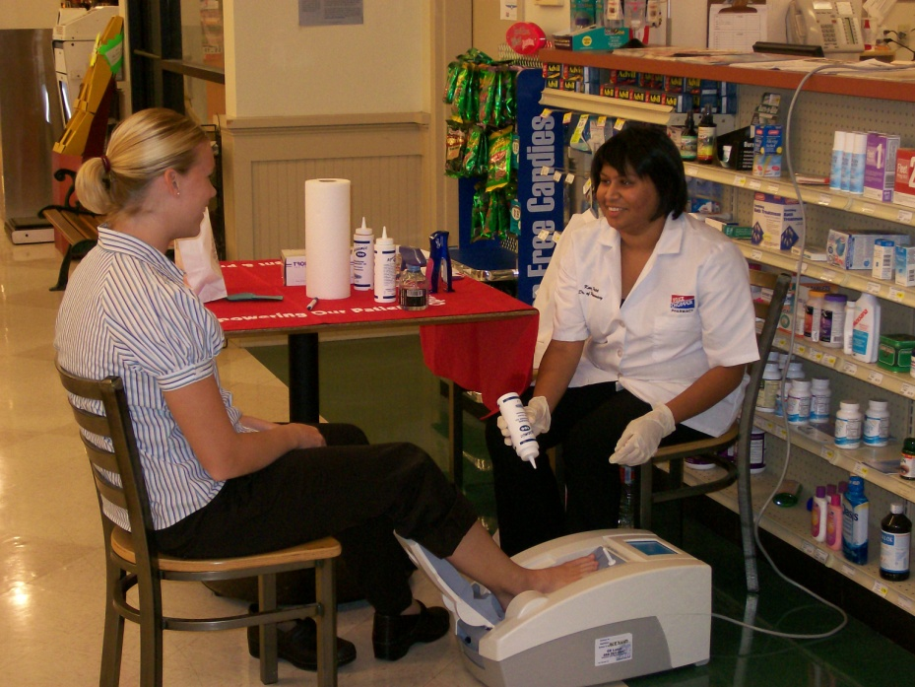
Practice Model Change - New Methods of Care
Community Pharmacies
Many examples of patient centered new care models, including:
Medication therapy management services
Therapeutic drug monitoring programs
Chronic disease management
Primary care and wellness programs
Collaborative drug therapy management
Patient assistance programs
Vaccinations
Walgreens new care model in their pharmacies
But these and others need to become the norm!

Slide 22
Practice Model Change - New Methods of Care
Transitions of Care Translates into One Medication-Use System Across All Settings
HOSPITAL
PATIENT
Community Pharmacist
Hospital Pharmacist
Clinic Pharmacist
Long-Term Care Pharmacist
Managed Care Pharmacist
COMMUNITY
CLINIC

Slide 23
Practice Model Change - New Methods of Care
Our Technician Workforce
State laws evolving:
42 states regulate technicians; 16 require certification
Need uniform laws for completion of accredited training program as prerequisite for technician licensure (ASHP Policy, June 2012)
Community pharmacies with ASHP-accredited programs:
Walgreens (nationwide)
Rite Aid (nationwide)
CVS (only in South Carolina)

Slide 24
Practice Model Change - New Methods of Care
Our Technician Workforce⁷
New Pharmacy Technician Certification Board (PTCB) Certification and Recertification Standards:
2015
Will require all 20 recertification CE hours to be pharmacy technician-specific
2020
Candidates must successfully complete an ASHP-accredited education program

Slide 25
The Accountable Care Organization
Connecting All Aspects of the
Medication-Use Continuum

Slide 26
The Accountable Care Organization
Connecting All Aspects of the Medication-Use Continuum
Understanding ACOs⁸
Restructuring of Health Care Delivery
Networks/groups of health care providers (physicians, hospitals, clinics, health-systems, community pharmacies, etc.) jointly responsible for patients
Settings of Care Necessary
Ambulatory Care
In-Patient Care
Long-term Care
“Triple Aim”
Reduce costs
Increase quality
Improve health in community at large

Slide 27
The Accountable Care Organization
Connecting All Aspects of the Medication-Use Continuum
Understanding ACOs⁹
Performance Requirements – 33 Measures of Quality in 4 Domains
Patient/caregiver experience (7 measures)
Care coordination/patient safety (6 measures)
Preventive health (8 measures)
At-risk populations (12 measures):
Diabetes (6 measures)
Hypertension (1 measure)
Ischemic Vascular Disease (2 measures)
Heart Failure (1 measure)
Coronary Artery Disease (2 measures)

Slide 28
The Accountable Care Organization
Connecting All Aspects of the Medication-Use Continuum
Understanding ACOs¹⁰
Pay for performance will be phased in over the ACO’s first agreement period as follows (as of June 2013):
Year 1: Pay for reporting applies to all 33 measures
Year 2: Pay for performance applies to 25 measures; pay for reporting applies to 8 measures
Year 3: Pay for performance applies to 32 measures; pay for reporting applies to 1 measure - a survey measure of functional status

Slide 29
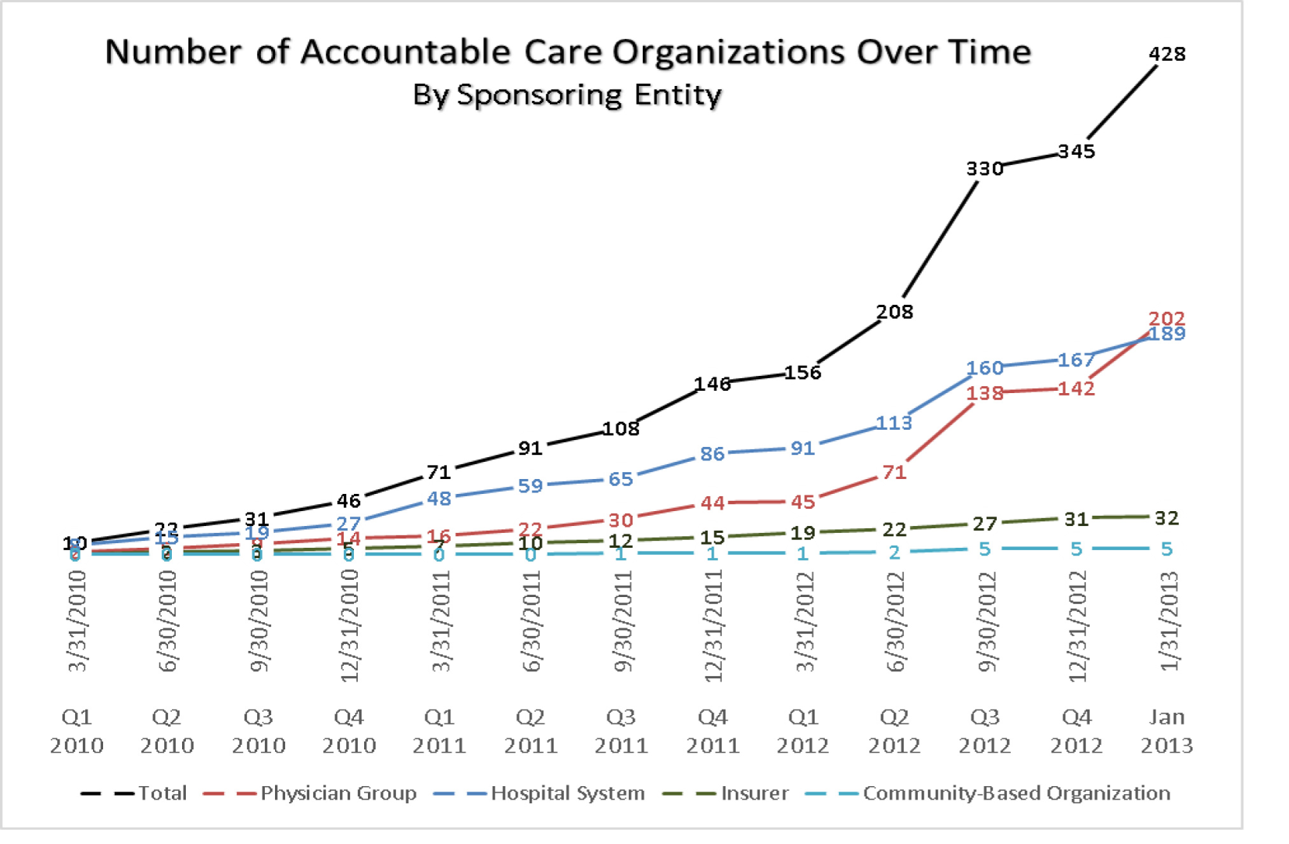
The Accountable Care Organization
Connecting All Aspects of the Medication-Use Continuum¹¹

Slide 30
The Accountable Care Organization
Connecting All Aspects of the Medication-Use Continuum
ASHP ACO Task Force¹²
13 individuals with administrative and clinical experience with ACOs in various health care settings
Purpose: To explore how pharmacy can improve medication use in the ACO model
Goals:
Improve medication outcomes in and across all sites of care
Reduce admissions and readmissions
Improve clinical processes of care
Enhance patient experience
Reduce cost of care

Slide 31
The Accountable Care Organization
Connecting All Aspects of the Medication-Use Continuum
ASHP ACO Task Force¹²
Recommendations:
Pharmacists need to more fully participate in ACO care design and provision
Identify and focus on high-risk patients and communicate across the health care continuum
Measure quality and financial impact of pharmacist on the ACO

Slide 32
The Accountable Care Organization
Connecting All Aspects of the Medication-Use Continuum
ASHP ACO Task Force¹²
Recommendations:
Redesign pharmacy services – “System of Care” Model
Deploy appropriate pharmacy resources across multiple settings
Allocate budgets based on:
Incorporate automation and technology to improve efficiency, accuracy, and convenience of patient care services
Disease Interventions Required Treatment

Slide 33
The Accountable Care Organization
Connecting All Aspects of the Medication-Use Continuum
New Trends and Developments¹³
ACO Pioneers – Mixed Reviews
Some Success
Gross savings: $87.6 million in 2012
Improved quality and performance for Medicare patients in 15 quality measures
For 670,000 Medicare beneficiaries in Pioneer ACOs, spending grew by only 0.3% vs 0.8% in conventional Medicare
Not so Successful
9 of 32 Pioneers will be leaving ACO program
13 Pioneers had shared Medicare savings
2 Pioneers owe Medicare program $4 million

Slide 34
The Accountable Care Organization
Connecting All Aspects of the Medication-Use Continuum
New Trends and Developments¹⁴
Hospital-Owned Insurance Plans:
Lower premiums; collected directly from patient
Eliminate health insurance companies – “middlemen”
Providers limited to particular health-system
18% of hospitals currently own health insurance companies
28% of hospitals expect to launch insurance plans within 5 years
New health plans may soon be offered on the Affordable Care Act’s health insurance exchanges
Example:
University of Pittsburgh Medical Center
Tiny start-up to now dominant health plan in western PA
Cost savings:
Medical services costs have increased 2% annually compared to 5.5-7.0% annually around the country
Own and sell proprietary software to assist other hospital-run plans to run health plan (such as phone operators to handle claims)

Slide 35
Enhancing the Public’s Understanding of the Vital Role of the Pharmacist in their Care

Slide 36
Enhancing the Public’s Understanding of the Vital Role of the Pharmacist in their Care
Patients need increased understanding of what pharmacists provide to improve medication outcomes, decrease adverse drug events, enhance safety and control the cost of their care
With this understanding, they will insist on access to the full services of pharmacists from employers and payors
Simultaneously, we should make the case to private and public payors that pharmacists will:
Decrease health care costs
Greatly expand access to care
Improve patient satisfaction

Slide 37
Enhancing the Public’s Understanding of the Vital Role of the Pharmacist in their Care
National publically reported quality measures and initiatives should expand and:
Include additional metrics related to optimal medication use
Include measuring patient’s understanding of their medication therapy
Track appropriate monitoring and follow-up for important medication therapies
Comprehensive pharmacy services should be included in the CMS Value Based purchasing program

Slide 38
Enhancing the Public’s Understanding of the Vital Role of the Pharmacist in their Care
Pharmacists are the most accessible health care professionals and should be utilized as such to play a much larger role in primary care and the management of chronic disease
Educate all patients on admissions

Slide 39
Obtaining Provider Status
for Pharmacists
A Fundamental Issue for Pharmacists

Slide 40
Provider Status – A Fundamental Issue
for Pharmacists
Why is it Important for the Pharmacists?
Absence reduces visibility → Implies secondary role → Impedes care provision
Extensive documentation of need and improvement in outcomes, cost, and access when pharmacists provide clinical services
Pharmacists practicing in clinics and expansion of services offered in community pharmacies will require financial support
Fundamental issue for full professionalization

Slide 41
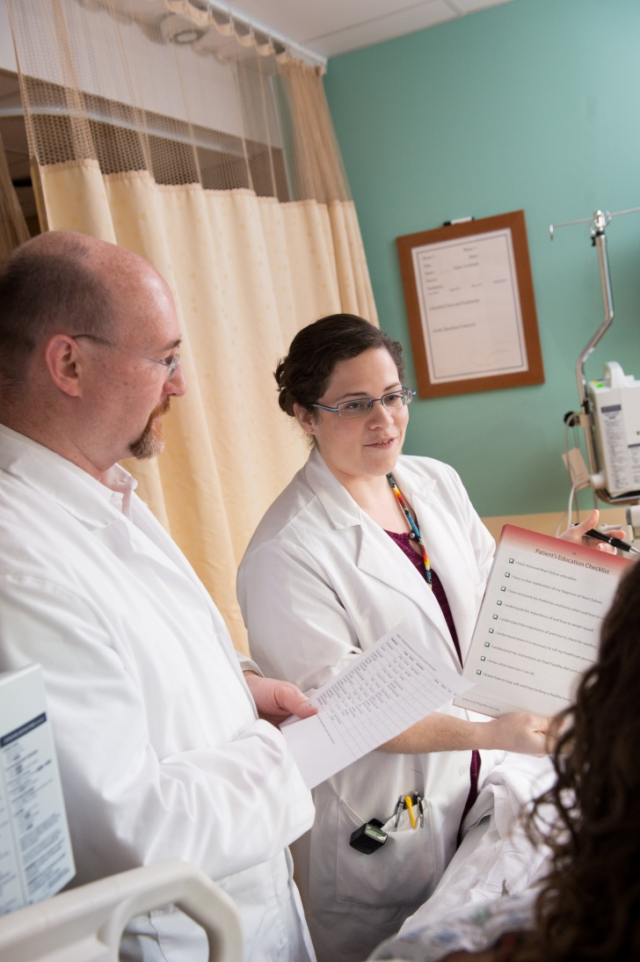
Provider Status – A Fundamental Issue
for Pharmacists
Why is it Important for
Pharmacists? (cont.)
Need pharmacists to provide primary care and manage chronic disease
Also opportunities for new care models
Pharmacists have and can:
Improve outcomes of care
Enhance medication safety
Reduce costs of care
Expand access to care
HOWEVER, they are constrained from universally doing so as incentives are inappropriately aligned to provide the necessary workforce

Slide 42
Provider Status – A Fundamental Issue
for Pharmacists
Implications for Pharmacists Regarding the Patient Protection and Affordable Care Act Roll-out¹⁵
By 2014 -- 30 million people will gain access to medical care
17,000 Primary Care Physicians are currently needed; another 40,000 more by 2025 to care for aging population
Pharmacists represent 3rd highest number of licensed health care providers (approx. 300,000)
Acknowledging pharmacists as non-physician providers in Social Security Act will allow licensed pharmacists to:
Work collaboratively with physicians and other providers
Optimize medication therapy in patients
Deliver best patient-centered care

Slide 43
Provider Status – A Fundamental Issue
for Pharmacists
Elements of Strategy and Process
The Provider Status Coalition
Coalition of Pharmacy Organizations
Actions:
Draft vision, core principles – agree on who are providers and what is provided
Obtain independent review of evidence of pharmacists’ value
Enlist support of Broader Coalition also including non-pharmacy health care organizations, providers, payors, patients and public
Work simultaneously at national, state and local levels

Slide 44
Provider Status – A Fundamental Issue
for Pharmacists
Elements of Strategy and Process (cont.)
Actions:
Federal Ask -- Amending the Social Security Act to Recognize Pharmacists—Preliminary Considerations
Pharmacists listed as providers in Medicare Part B with a list of specified covered services (SSA Section 1861)
Additional pharmacists’ services could later be approved by the HHS Secretary
Pharmacists also listed as providers in ACOs (SSA Section 1899)
Obtain mock CBO scores (i.e., estimated cost to the federal budget)
Possibly modify Federal Ask based on CBO scores

Slide 45
Provider Status – A Fundamental Issue
for Pharmacists
Elements of Strategy and Process (cont.)
Effective marketing materials
Identify “high profile” leaders, key congressional supporters, and other advocates
Educate pharmacists and other providers
State and grassroots campaigns
Individual pharmacy practitioners
State pharmacy societies and associations
Marshall support of Colleges of Pharmacy, including pharmacy students to assist
Public education using social media
Multi-year strategy; achieving provider status will not be easy

Slide 46
Provider Status – A Fundamental Issue
for Pharmacists
Major Strides Have Already Been Achieved – National Efforts
Oct 2011: Centers for Medicare & Medicaid Services (CMS) – Changed Conditions of Hospital Participation¹⁶
Recognized Pharmacists as a “Non-Physician” Providers
Hospitals can now recognize pharmacists as providers through credentialing/privileging process
ADVOCATE!

Slide 47
Provider Status – A Fundamental Issue
for Pharmacists
Major Strides Have Already Been Achieved – State Efforts¹⁷
October 2013: California Governor signed into law pharmacist provider status bill (SB 493). Law allows pharmacists to:
Create “advanced practice pharmacist” category
Perform patient assessments
Initiate, adjust or discontinue drug therapy
Participate in the evaluation and management of diseases and health conditions in collaboration with other health care providers
Order and interpret drug therapy-related tests
Refer patients to other health care providers
Independently initiate and administer vaccines
ADVOCATE!

Slide 48
Provider Status – A Fundamental Issue
for Pharmacists
Major Strides Have Already Been Achieved – State Efforts (cont.)
Feb 2013: U.S. Attorney General, Washington State, Opinion Letter¹⁸
Acknowledged pharmacists as health care providers under Washington’s law, “every category of provider” RCW 48.43.045
Pharmacists can provide services or care for conditions included in basic health plan services and should be compensated for their services
These services are within the scope of pharmacists’ practice
ADVOCATE!

Slide 49
Provider Status – A Fundamental Issue
for Pharmacists
Major Strides Have Already Been Achieved – State Efforts (cont.)
Advanced Practice - Clinical Designation¹⁹
Common Job Title
Pharmacy Clinician
Clinical Pharmacy Practitioner
Current States:
North Carolina
New Mexico
California
ADVOCATE!

Slide 50
Pharmacist Interdependent Prescribing
Optimizing Patient Outcomes

Slide 51
Pharmacist Interdependent Prescribing
Optimizing Patient Outcomes
Interdependent Prescribing – Evolution of Collaborative Drug Therapy Management (CDTM)
Changing Delivery of Care Model as it Relates to Prescribing²⁰
Current model:
Vertical
Dependent
Pharmacist and physician, working together with other members of the health care team, and forming a strategic partnership to optimize patient outcomes with medications.
Proposed model:
Horizontal
Interdependent

Slide 52
Pharmacist Interdependent Prescribing
PHYSICIAN
Makes initial diagnosis
*PHARMACIST
Based on physician diagnosis, selects & designs drug therapy regimen
PHYSICIAN / PHARAMACIST / NURSE
Reviews and monitors patient’s drug therapy for efficacy and adverse events
PHARMACIST
Changes medication orders, consulting with physician and nurse as needed
Writes prescription or medication orders
Treats and monitors patient
Optimizing Patient Outcomes
Proposed Horizontal Model²⁰
*In specific patients and specific situations previously determined by both the physician and the pharmacist
OUTCOME: Improved outcomes and reduced costs. Better utilization of physician, nurse and pharmacist’s time.

Slide 53
Pharmacist Interdependent Prescribing
Optimizing Patient Outcomes
Existing International Models
U.K.²¹:
Supplemental prescribing
Independent prescribing in area of pharmacist’s expertise
Canada – Effective October 2012, Ontario²²:
Initiate therapy for smoking cessation
Renew and adapt prescriptions
Administer injections or inhalation (for education and demonstration)
Administer the flu vaccine
Quebec allowing pharmacists to prescribe medications that do not require a diagnosis, i.e.²³:
Antimalaria medications for travelers
Australia: Currently in development
National prescribing competencies
Scope of practice

Slide 54
Final Thoughts
Putting it All Together
We need to educate the public as to the role of the pharmacist in patient care.
Pharmacists in different sites of care must work together to provide the full spectrum of care.
We need an increased emphasis on care basics, such as adherence, design of affordable drug therapies, elimination of unnecessary drug use, chronic disease management, wellness and primary care.

Slide 55
Final Thoughts
Putting it All Together
There should be an increased pharmacy presence in clinics, medical homes, ACOs, etc.
Staying focused on what is right for the patient will always be our best strategy.
Our models of practice must change significantly to achieve the above.

Slide 56
When I grow up, I want a pharmacist on my healthcare team!

Slide 57
Post - Questions
1. Pharmacists will become essential members of all health care teams because:
The complexity of medication therapy requires a drug therapy expert if appropriate care outcomes are to be achieved and maintained
Pharmacists have the education and training to maximize patient outcomes and control health costs
Pharmacists are the most accessible health care practitioner
All of the above

Slide 58
Post - Questions
For pharmacists to obtain provider status and to practice at the highest level, which of the following advocacy efforts will it require:
a) Strong and cohesive national coalitions of pharmacy associations, patient and consumer groups, and other healthcare organizations
b) Grassroots efforts from individual pharmacy practitioners and affiliated societies
c) Both
d) None of the above

Slide 59
Post - Questions
Advancing pharmacist interdependent prescribing ultimately helps to:
a) Optimize and improve patient outcomes
b) Reduce patient and healthcare costs
c) More effectively maximize the use of all health care team members
d) All of the above

Slide 60
References
Keehan S, Cuckler G, Sisko A, Madison A, et al. National health expenditure projections: Modest annual growth until coverage expands and economic growth accelerates. Health Affairs, June 2012, Retrieved July 8, 2013 at http://content.healthaffairs.org/content/early/2012/06/11/hlthaff.2012.0404.abstract l
IOM, 2012, Best Care at Lower Cost.
Abramowitz P. The evolution and metamorphosis of the pharmacy practice models. Am J Health-Sys Pharm. 2009; 66:1437-1440.
MoHLTC. Inter-professional care: A blueprint for action in Ontario. August 20, 2007.
Benjamin R. Letter to Scott Giberson, Chief Professional Officer, Pharmacy, U.S. Assistant Surgeon General. Dec. 14, 2011.
Pedersen C, Schneider P, Scheckelhoff D. ASHP national survey of pharmacy practice in hospital settings: Monitoring and patient education – 2012. Am J Health-Sys Pharm. 2013; 70: 787-803.
PR Newswire. Pharmacy Technician Certification Board announces certification program changes. Retrieved on August 21, 2013 at http://www.prnewswire.com/news-releases/pharmacy-technician-certification-board-announces-certification-program-changes-193664121.html

Slide 61
References
Calman N. Hauser D. Chokshi D. Lost to follow-up: The health goals of accountable care. Arch Intern Med. 2012; 172(7): 584-586.
CMS. Guide to quality measurement for Accountable Care Organizations starting in 2012: Agreement period, performance year, and reporting period. Retrieved on March 22, 2013 at http://www.cms.gov/Medicare/Medicare-Fee-for-Service-Payment/sharedsavingsprogram/Downloads/ACO-Guide-Quality-Measurement-2012.pdf
Office of Clinical Standards & Quality. CMS. Accountable Care Organization 2012 Program Analysis. 2011. Retrieved on August 21, 2013 at http://www.cms.gov/Medicare/Medicare-Fee-for-Service-Payment/sharedsavingsprogram/Downloads/ACO_QualityMeasures.pdf
Muthlestein D. Continued growth of public and private ACOs. Health Affairs, http://healthaffairs.org/blog/2013/02/19/continued-growth-of-public-and-private-accountable-care-organizations/
ASHP Report. Report of the 2012 ASHP Task Force on Accountable Care Organizations. Am J Health-Sys Pharm. 2013;70:66-76.

Slide 62
References
Gold J. 9 Pioneer ACOs Jump Ship After First Year. Kaiser Health News. Retrieved July 22, 2013 at http://capsules.kaiserhealthnews.org/index.php/2013/07/9-pioneer-acos-jump-ship-after-first-year/
Kliff A. Is this the end of health insurers? Washington Post. Retrieved July 8, 2013 at http://m.washingtonpost.com/blogs/wonkblog/wp/2013/07/05/want-to-kill-health-insurers-this-start-up-is-teaching-hospitals-how/
MacKinnon GE. Recognizing pharmacists as healthcare providers – a solution for the Patient Protection and Affordable Care Act roll-out. Formulary Journal. 2013, September. 48:300-302.
Dept. of HHS. CMS. Medicare and Medicaid Programs; Reform of hospital and critical access hospital conditions of participation. Federal Register. 2011. 76(205):65891-908, Retrieved on February 5, 2013 at https://www.cms.gov/Regulations-and-Guidance/Legislation/CFCsAndCoPs/downloads/CMS3244P.pdf
California provider status bill becomes law. Retrieved on October 5, 2013 at http://www.pharmacist.com/california-provider-status-bill-becomes-law

Slide 63
References
Community Pharmacy Foundation. Retrieved on February 6, 2013 at http://www.communitypharmacyfoundation.org/resources/grant_docs/CPFGrantDoc_52258.pdf
Murawski M, Villa K, et al. Advanced-practice pharmacists: Practice characteristics and reimbursement of pharmacists certified for collaborative clinical practice in New Mexico and North Carolina. Am J Health-Sys Pharm. 2011; 68: e47-e56.
Abramowitz P, Shane R, et al. Pharmacists interdependent prescribing: A new model for optimizing patient outcomes. Am J Health-Sys Pharm. 2012;69:1976-81.
Department of Health. Pharmacist independent prescribing FAQ. 2010. www.dh.gov.uk/en/Healthcare/Medicinespharmacyandindustry/Prescriptions/TheNon-MedicalPrescribingProgramme/Independentpharmacistprescribing/DH_4133943
Ontario College of Pharmacists. Understanding your pharmacist’s expanded role. Retrieved September 5, 2013 at http://www.ocpinfo.com/Client/ocp/ocphome.nsf/object/Brochure/$file/Exp_Role_Letter.pdf
Legislative change in Quebec gives pharmacists expanded authorities. Can Pharm J. 2012;145:7.

