Slide 1
Living With Epilepsy
@ The Matty Fund
By: Tolani Olagundoye

Slide 2
Statistics on Epilepsy
3 million
Americans!
Foundation, Epilepsy. "What Is Epilepsy." N.p., 2012. Web. 04 Sept. 2013.
Notes:
Insert a chart in this slide template to illustrate your topic visually, then use bullets or color to call out key findings or points from your chart in a brief format.

Slide 3
What is Epilepsy?
Epilepsy is considered a brain disorder that can affect a patient mentally and physically.
A patient is considered to have epilepsy after having two or more seizures with unknown causes.
Foundation, Epilepsy. "What Is Epilepsy." N.p., 2012. Web. 04 Sept. 2013.

Slide 4
What occurs during a seizure
Normal brain
Epileptic brain
During a seizure hyperactivity activities occurs in the brain, the nerve cells stops their normal activities, and fires signals into many different area of the brain. The Brain gains control after a few seconds or minutes.
Weber Foundation, The Sturge. "The Sturge Weber Foundation." Seizures. N.p., 2013. Web. 05 Sept. 2013.

Slide 5
What are the causes of epilepsy?
Head injuries
Lack of oxygen to brain.
Brain tumors
Genetic conditions
    Tuberous sclerosis, lead poisoning, and infections such as meningitis or encephalitis.
Notes:
head injuries or lack of oxygen during birth may damage the delicate electrical system in the brain.
problems in development of the brain before birth,

Slide 6
How to diagnosis epilepsy…
Neuroimaging evaluation (MRI, CT scan, etc.)
EEG
Prolactin levels
CSF exam
Notes:
=Abnormality on the EEG can be used to detect if a patient is epileptic and a lack of abnormality does not excluded a patient either
=If the Prolactin level is elevated 3-4 folds then there is a chance
=CSF(Cerebral spinal fluid) examination in patients with obtundation (Obtundation refers to less than full mental capacity in a medical patient, typically as a result of a medical condition or trauma.) or in patients in whom meningitis or encephalitis is suspected

Slide 7
Treatments
What’s used first?
Oral medication
A special Diet
What’s used last?
Surgery
Implanted device.
Notes:
The special Diet used is called the Ketogenic diet

Slide 8
medications
Topamax
Lyrica
Trileptal
Neurontin (gabapentin)
Tegretol (carbamazepine)
Trileptal (oxcarbazepine)
Topamax (topiramate)
Zonegran (zonisamide)
Lyrica (pregabalin)

Slide 9
Drug question 1
Which of the following is NOT correct about Lacosamide?
  A. Brand name is Vimpat.
  B. The most frequent adverse effects are dizziness, HA, N/V, fatigue, somnolence and ataxia.
  C. It is a schedule V controlled substance.
  D. It is a strong inducer of CYP3A4; and it can reduce serum concentrations and effectiveness of many medications.
  E. It is used to treat epilepsy
PassNaplex.com
Notes:
Would anybody like to guess what the answer to this question is? Answer is D. Vimpat is a substrate and inhibitor of CYP2C19.

Slide 10
Drug question 2
Which of the following is NOT correct about Zonisamide?
  A. Brand name is Zonegran
  B. It may cause hyporthermia.
  C. It can cause psychomotor slowing, and impaired concentration.
  D. It is a carbonic anhydrase inhibitor and can cause metabolic acidosis, which increases the risk of renal stones.
  E. It is used for epilepsy.
Notes:
Answer is B: It can actually cause hyperthermia. Zonisamide can cause hyperthermia and heat stroke NOT hypothermia.

Slide 11
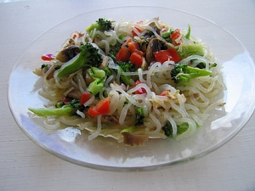
The Ketogenic Diet
The ketogenic diet is the non-pharmacological treatment for epilepsy.
Research shows that the Ketogenic diet works for some patients with epilepsy
There are different types of foods on the ketogenic diet. There are some foods that are Gluten free, Casein free or both Gluten & Casein free.
Notes:
There are many different foods in the ketogenic diet.
-avocado, omelets, salad, pancakes, cakes, brownies. Many different foods.

Slide 12
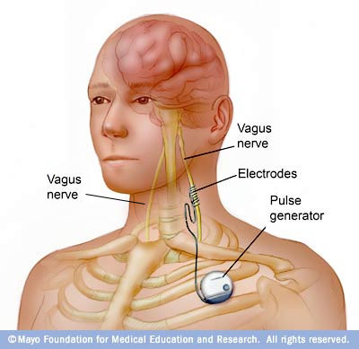
Implantated Device
The vagus nerve stimulator is implanted in the brain and it helps to deliver current pulses to interrupt some discharges that the brain may produce.

Slide 13

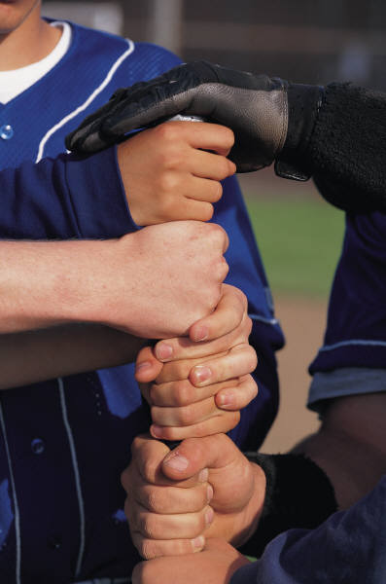
THE MATTY FUND
The Matty Fund is a non- profit organization that began in 2003.
The Matty Fund organization is dedicated to providing aid for Epilepsy research and education, Epilepsy awareness through educational programs and annual scholarships to high school seniors diagnosed with Epilepsy.
Notes:
=The Matty Fund is a non- profit organization that began in 2003 by a married couple whose son, Matthew Siravo, passed away from Epilepsy on May 11, 2003.

Slide 14

The Matty Fund
The goals of these family support group events are to provide a safe, secure, and stimulating environment to nurture new friends and create a support network for the siblings and parents of those with epilepsy.
The workers at Matty Funds also went to schools around Rhode Island to educate students how to handle situations where a seizure occurs.
Notes:
At the Matty Fund there were many family support group events that were created for children, teens and their families living with epilepsy. The Matty Fund teaches these children and teens on how to help one another understand the many life changes associated with epilepsy.

Slide 15
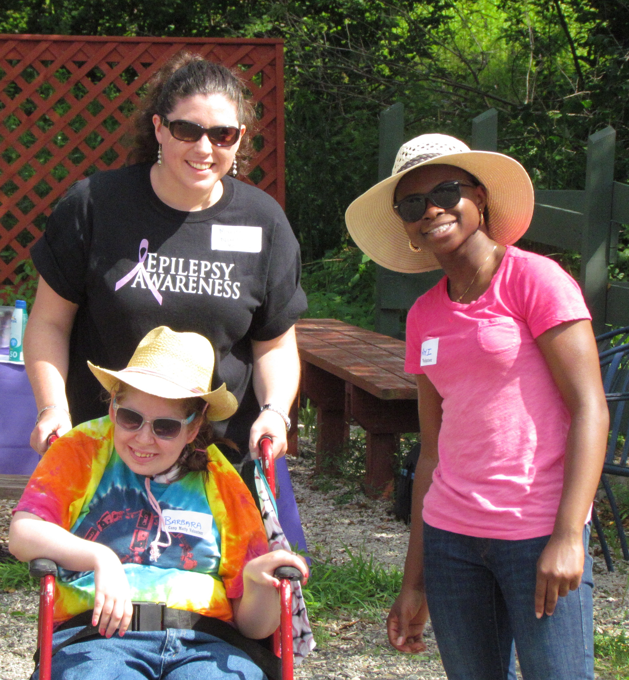
Camp matty
This summer I got the chance to attend camp matty for a week.
Camp matty took place at the lend a hand therapeutic riding foundation.
Facebook: https://www.facebook.com/LendAHandRI
Notes:
Lend A Hand Therapeutic Riding Foundation, is a 501(c)(3) non-profit
providing therapeutic riding and hippotherapy for children and adults with
physical, mental, social and emotional disabilities, located on a working farm.
Lend a hand is located in Cranston, RI

Slide 16
The Matty Fund
Website: Mattyfund.org
Mailing Address: The Matty Fund® P.O. Box 5300 Wakefield, RI 02880
Physical Address: Matthew Siravo Epilepsy Resource Center for Children & Families 10 High Street - Suite F Wakefield, Rhode Island 02879 Telephone: (401) 789-7330
Fax: (401) 789-7364
Catherine Mureddu, Events & Programs Coordinator: Catherine@MattyFund.org
George Donnelly, Executive Director: MattyFund@cox.net
Jessie Kenyon, Family Outreach Coordinator: Jessie@MattyFund.org
Linda Lynch, Development & Outreach Director: Linda@MattyFund.org
Catherine Mureddu, Events & Programs Coordinator: Catherine@MattyFund.org
Notes:
For upcoming events, volunteering opportunities, workshops, etc.

Slide 17
Any Questions?!?

