Slide 1
Enhancing the Medication Reconciliation Process during Transitions of Care Utilizing Student Pharmacists
Marco DelBove, Pharm.D.
Memorial Hospital of Rhode Island
RISHP Showcase
November 2, 2013

Slide 2
Disclosures
I have no financial disclosures.

Slide 3
Objectives
To describe the process for integrating student pharmacists in the medication reconciliation process for MHRI Home Care patients.
To describe the process for developing a tracking and reporting tool for student pharmacists’ recommendations and interventions.
To highlight future developments for our students’ roles.

Slide 4
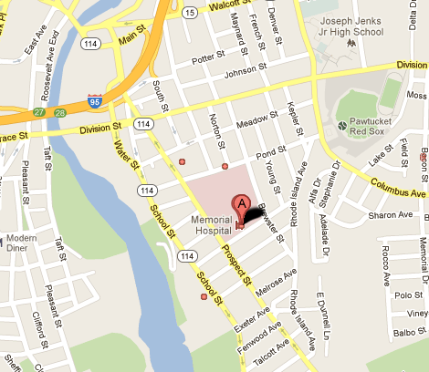
Memorial Hospital of RI
Pawtucket, RI
APPE Institutional Rotation for URI student pharmacists
MHRI Home Care is now VNA of CNE

Slide 5
Transitions of Care
Background
Spring 2012
Identified an opportunity for improvement in medication reconciliation upon admission to Home Care services
Utilize student RPhs as a resource
Piloted with first 2 students in Summer 2012

Slide 6
Medication Reconciliation
Process of comparing the medications a patient is taking (and should be taking) with newly ordered medications in order to resolve discrepancies or potential problems
Obtain the most complete and accurate list of medications
Occurs upon transitions of care between healthcare organizations
Multidisciplinary

Slide 7
Student RPh Training
Structure of rotation
Weekly schedule
Initial goals, midpoint and final evaluations
Final oral and written presentations
Hospital orientation
General introduction
Institutional requirements
Process for medication reconciliation/counseling (ASHP Position Statements)
Home Care orientation
General introduction and expectations
Scheduling
Patient etiquette

Slide 8
Interventions
Medication Reconciliation
Duplicate meds
Omitted meds
Correct dose
Discontinuing meds
Therapeutic substitutions
Medication Teaching
Assistance with setting up weekly pill boxes
Identifying indications for medications
Scheduling medication times
Inhaler technique
Expiration dates

Slide 9
Staff Education
Drug information requests PRN
Final presentation to Home Care staff
Heart failure medications
New anticoagulants
Warfarin education
Insulin therapy and available formulations
Hypertension
Calculations competency

Slide 10
Barriers
Electronic systems (lack of)
Access to patient charts
Scheduling
Follow-up visits
Lack of consistent method of tracking interventions
Ability to complete intervention/contact provider

Slide 11
Staff Survey
After 6 rotations, a survey was completed by Home Care staff
Physical Therapists, Occupational Therapists, and Speech-Language Pathologists
Focus on before and after experience with student RPhs
Comfort level and confidence with:
Medication reconciliation
Medication teaching
Seeking a pharmacist for assistance
Twenty-one surveys received

Slide 12
Survey Results
Improvement in staff comfort level (baseline and after experience)
Reconciliation: 61%
Teaching: 70%
Interpretation
Difficult to define and quantify staff comfort level, but results demonstrates an impact

Slide 13
New Developments
Healthcentric Advisors—Safe Transitions Program
June, August 2013
University of Rhode Island
Memorial Hospital of RI
South County Hospital
Newport-Bristol VNS
Standardized implementation and measurement strategy
Student RPh orientation
Tracking tool

Slide 14
Student Pharmacist Orientation
Orientation with URI faculty and community practice resident
Focus on home health systems
Expectations
Effective communication
Teach-back method
Staff development

Slide 15
Tracking Tool
Standardized method for compiling and tracking interventions
Process and outcome measures
# of patients and relevant diagnoses
Type of visit (med rec on admission, med teaching)
# and type of interventions
% accepted, # of provider calls
Student RPh and Home Care staff experience
Training and education

Slide 16
Future Goals
Utilize enhanced tracking tool
Follow-up discussion planned
Collect and submit data
Outcomes—Impact of interventions
Staff experience
30-day readmissions?
Develop a stand-alone APPE rotation
ASHP Midyear Clinical Meeting

Slide 17
Thank you!
Marco DelBove, Pharm.D.

